Slide 1

IoT Security Framework: Protecting the Connected World
This presentation outlines a comprehensive framework for securing Internet of Things (IoT) devices and systems, ensuring the safety of connected data and operations.
T. Ashok(192312558)
M. Prakesh Reddy(192312561)

Slide 2
Understanding IoT Security Challenges and Threat Landscape
Increased Attack Surface
Data Privacy and Security Concerns
Limited Resources and Expertise
The proliferation of IoT devices creates a vast attack surface for malicious actors to exploit vulnerabilities.
IoT devices collect sensitive data, raising concerns about privacy and the need for strong security measures.
Many IoT devices lack robust security features due to limited processing power and memory, requiring innovative solutions.

Slide 3
Key Components of an IoT Security Framework
1
Device Security
2
Network Security
Protecting devices at the hardware and firmware level.
Securing communication channels and data transfer.
3
Cloud Security
4
Identity and Access Management
Safeguarding backend infrastructure and data storage.
Controlling access to devices and systems.
5
Security Monitoring and Incident Response
6
Compliance and Regulatory Requirements
Detecting and responding to security threats.
Adhering to industry standards and legal frameworks.

Slide 4
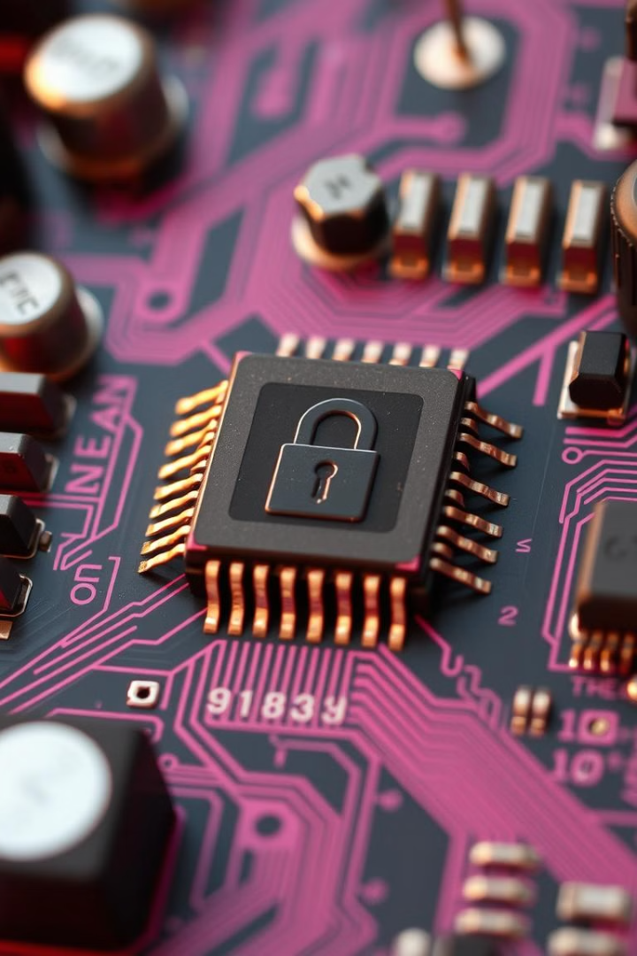
Device Security: Hardware and Firmware Protection
Secure Boot
Hardware-based Security
Ensuring that only authorized firmware loads onto the device.
Using tamper-resistant chips and secure enclaves to protect sensitive data.
Regular Firmware Updates
Patching vulnerabilities and improving security over time.

Slide 5




Network Security: Communication and Data Transfer
Encryption
Firewalls
Virtual Private Networks (VPNs)
Protecting data in transit and at rest.
Blocking unauthorized access to the network.
Creating secure tunnels for communication.

Slide 6

Cloud Security: Backend Infrastructure and Storage
1
Secure Infrastructure
Employing robust cloud security measures, including encryption, access controls, and intrusion detection.
2
Data Backup and Recovery
Ensuring data availability and resilience in case of a security breach.
3
Cloud Security Auditing
Regularly reviewing and assessing cloud security posture.

Slide 7




Identity and Access Management in IoT Systems
Strong Authentication
Utilizing multi-factor authentication for robust access control.
Role-based Access Control (RBAC)
Granting permissions based on user roles and responsibilities.
Secure Credentials Management
Storing and managing access credentials securely.

Slide 8

Security Monitoring and Incident Response
Incident Response Plan
Threat Detection
Having a defined process for handling security incidents.
Continuous Monitoring
Employing security analytics and machine learning to identify potential threats.
Actively tracking network traffic, device behavior, and security logs.

Slide 9



Compliance and Regulatory Requirements for IoT Security
GDPR
1
Protecting personal data in the European Union.
HIPAA
2
Securing healthcare information in the United States.
NIST Cybersecurity Framework
3
Providing guidance on cybersecurity best practices.

Slide 10
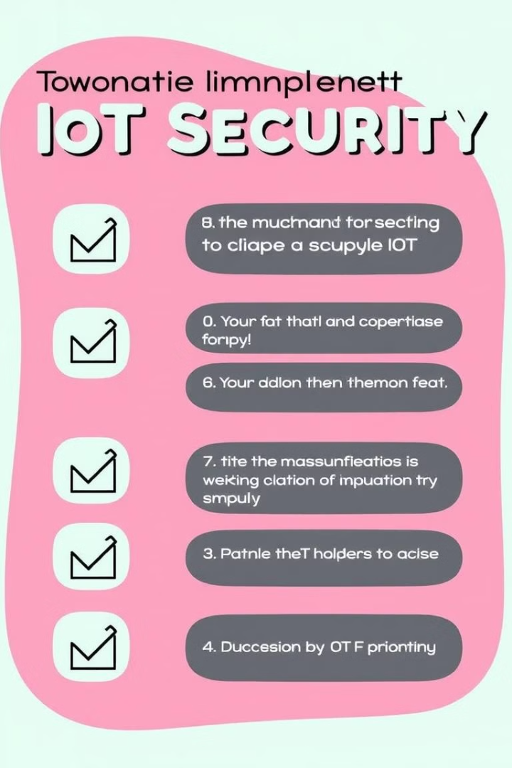
Implementation Guide and Best Practices
A comprehensive IoT security framework is essential for protecting the connected world. By implementing these key components, businesses can mitigate risks, enhance security posture, and ensure the safety of their connected devices and systems.

